Slide 1
Commercial Card
Expense Reporting (CCER)
The University of Puget Sound
An internet solution
Accessed via Wells Fargo’s secure Commercial Electronic Office® (CEO) portal

Slide 2
Commercial Card Expense Reporting (CCER)
What is it?
CCER is an internet reporting solution that allows on-line access to your card transactions at any time, from any location. It is accessed via Wells Fargo’s secure Commercial Electronic Office® (CEO®) portal.
Cardholders can:
Review/reclassify transactions
Input a business description for all transactions
Split transactions
Add OOP (out-of-pocket expenses)
Email, fax, or upload receipts via desktop or CEO mobile
Approvers can:
Approve individual “OOP” transactions
Review/approve cardholder statements
View receipts and statement summary reports

Slide 3
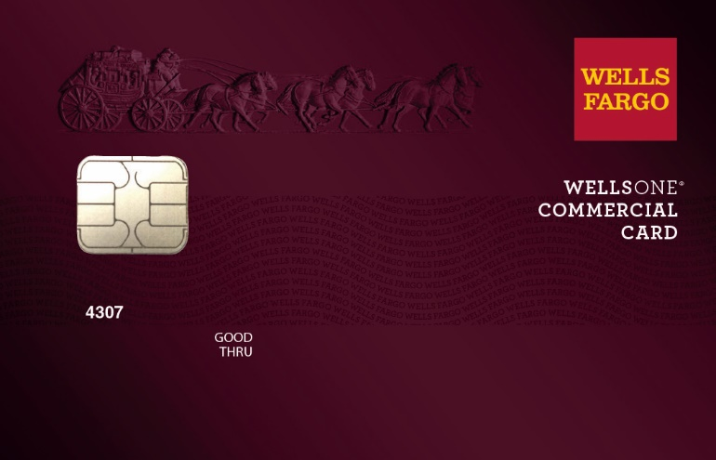
To get started
After receiving your card…
Activate your card by calling the toll free number located on the activation sticker
During activation you will need your Unique Identification Number (ID) – if you do not know your Unique ID, please contact your internal Program Administrator to obtain
During activation you will be asked to create a customized Personal Identification Number (PIN)
Sign the back of your card
Record the Wells Fargo Customer Service number (1-800-932-0036) located on the back of your card in your mobile device, or address book
Sign on to the CEO and initialize your CEO User ID

Slide 4
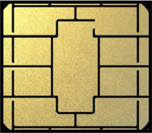
Chip and PIN Cards
Card security
To enhance the security of your credit card purchases, your new commercial card will feature chip and personal identification number (PIN) technology, in addition to a magnetic stripe. With this card, you will have added identity verification and more flexibility at chip-enabled and traditional magnetic stripe terminals.
About chip-enabled cards
Most U.S. merchants use terminals that accept chip-enabled credit cards (cards that contain an integrated “circuit chip” that stores encrypted information). If you encounter a merchant that doesn’t, you may use your card by swiping at the point of sale.
Chip-enabled terminals are used internationally. You may use your card to complete chip-enabled transactions in Europe, Asia, South America, and Canada.
When you activate your card (by calling the provided number on the activation sticker), you will select a customized Personal Identification Number (PIN). Use this PIN for all chip-enabled transactions, as well as for cash advances, if you are authorized to make them.
Whether in the U.S. or abroad, the first time you use your card to complete a chip-enabled transaction, you may be prompted to provide your signature instead of your PIN. After the first use, you will only need your PIN to complete chip-enabled transactions.
If you forget or need to change your PIN, call the WellsOne Service Center at 1-800-932-0036.
4

Slide 5
New User Sign On
Sequence of steps
Sign on to the Commercial Electronic Office® (CEO®) using your temporary password
Change your password
Set up your secret questions
Read and accept the CEO Terms of Use
Confirm your profile information

Slide 6
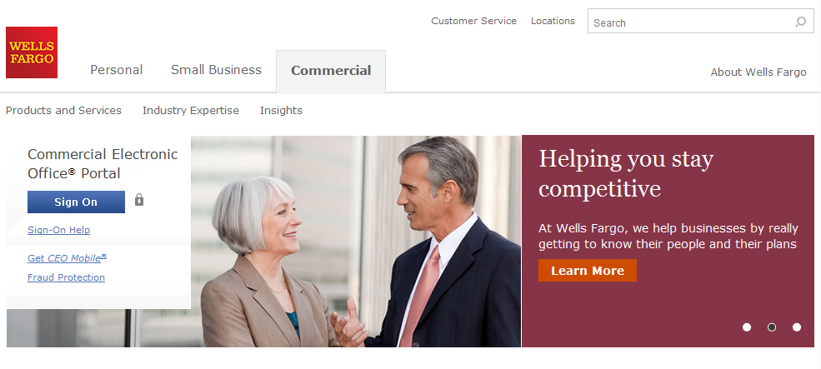
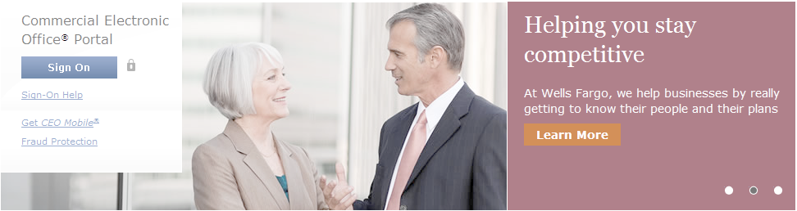
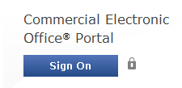
Wells Fargo home page wellsfargo.com

Slide 7
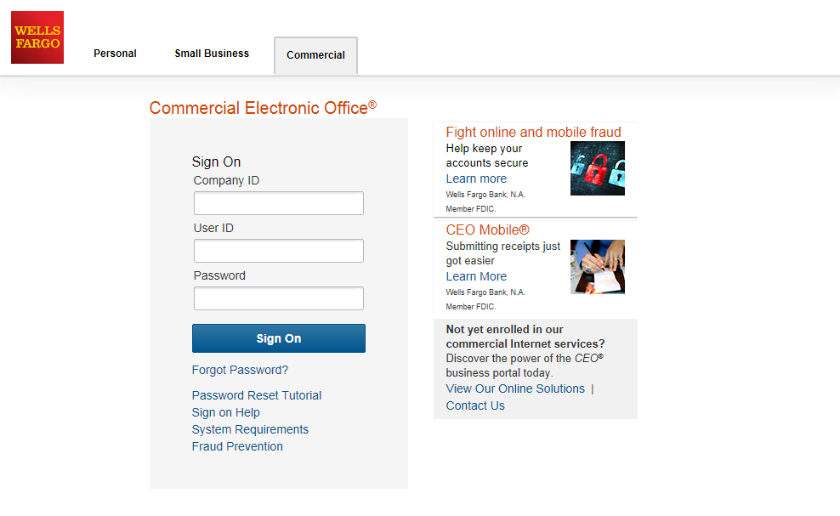
CEO portal sign-on website https://wellsoffice.wellsfargo.com
Enter your:
Company ID
  UNIVE186
User ID
  Unique to user
Password
  Unique to User
Company ID, User ID and Password
are not case sensitive
To change or reset your password, click the Forgot Password? link
If you incorrectly enter your password twice in the same session, you will automatically be taken to the Change Your Password page

Slide 8
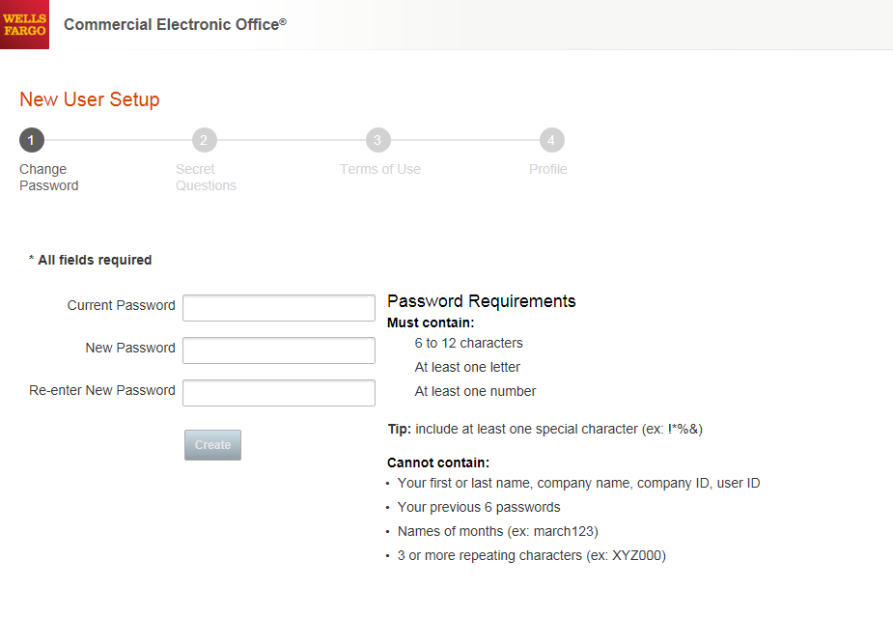
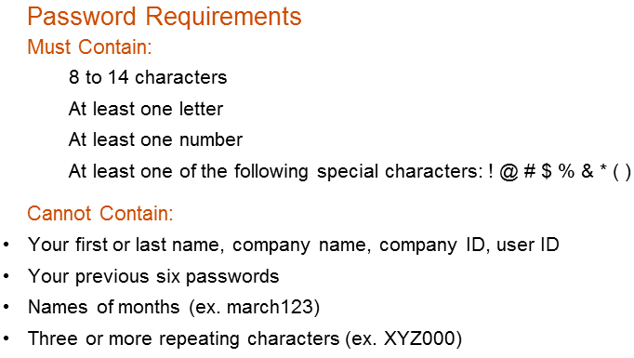

Change your password
●●●●●●●●●
●●●●●●●●
●●●●●●●●

Slide 9
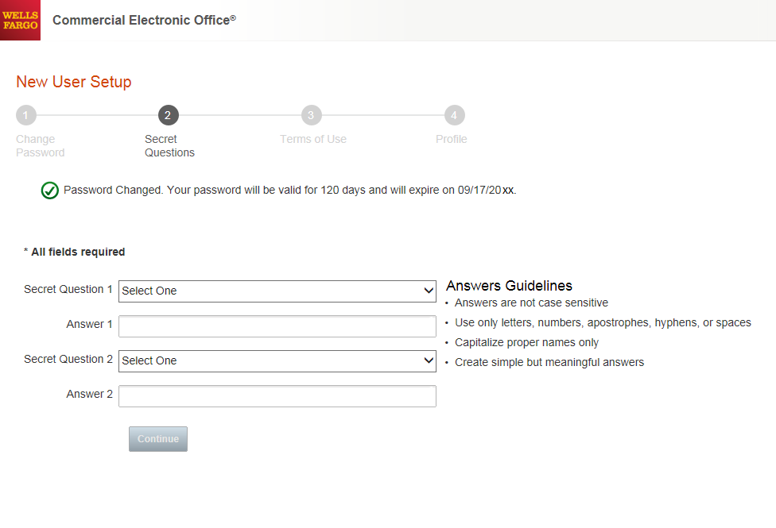
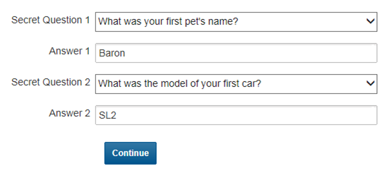
Set up your secret questions

Slide 10
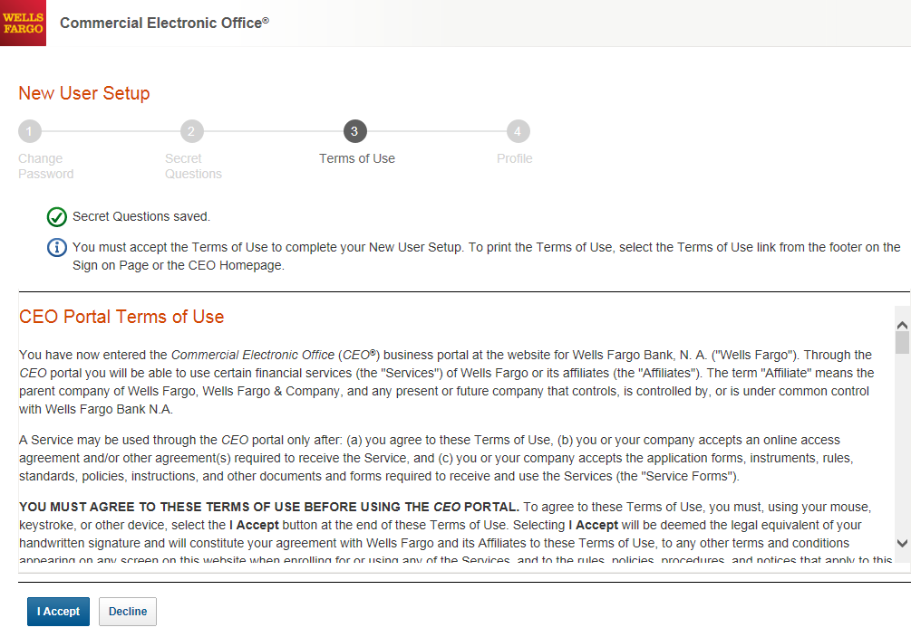
Read and accept the CEO Terms of Use

Slide 11
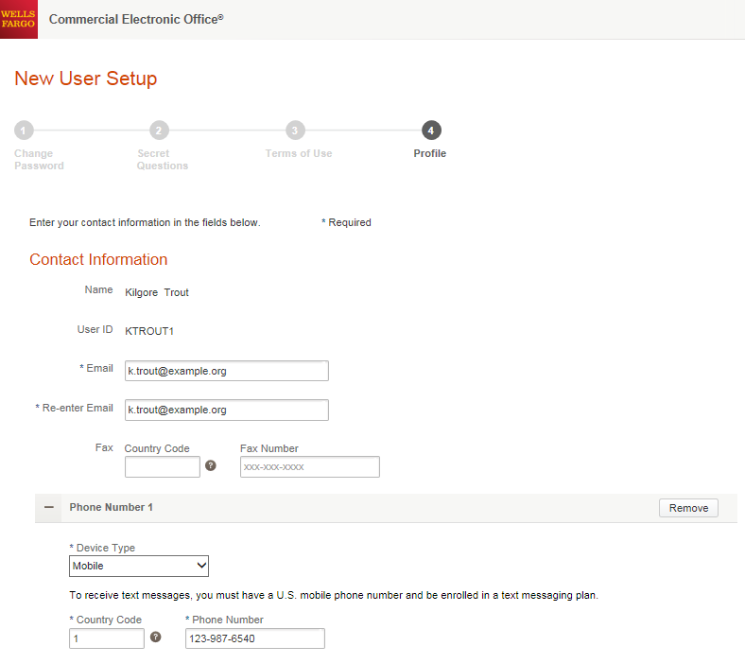
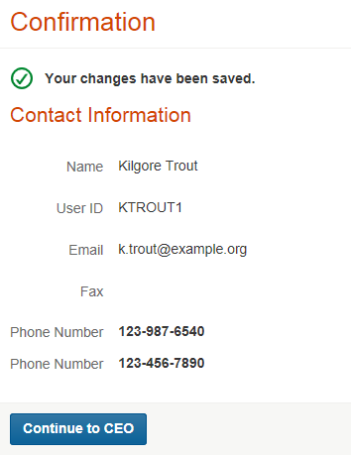

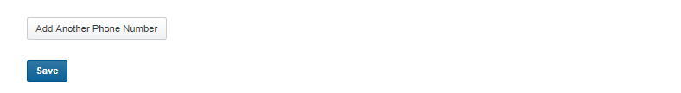
Confirm your profile Contact Information
Enter your email and phone information; Save, then Continue…
11

Slide 12
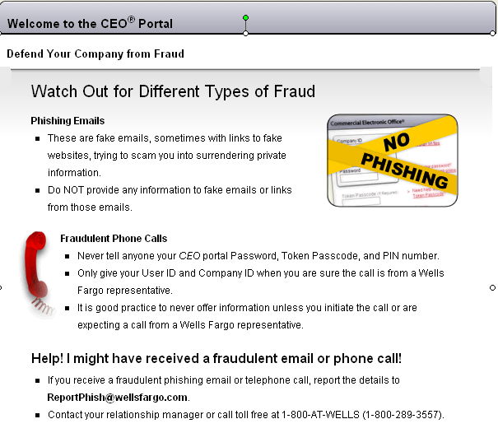

Slide 13
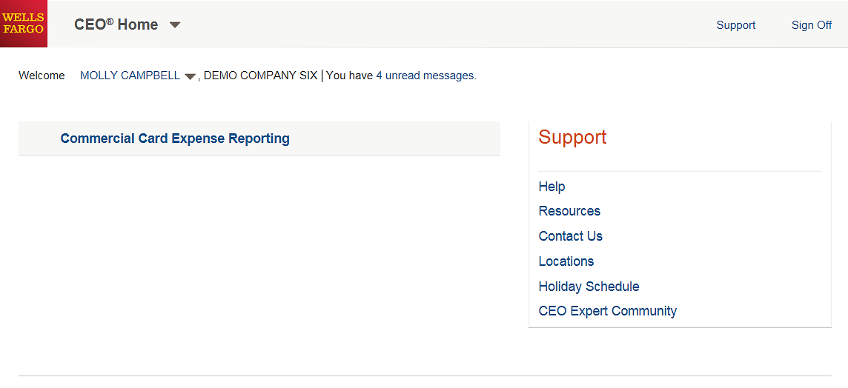
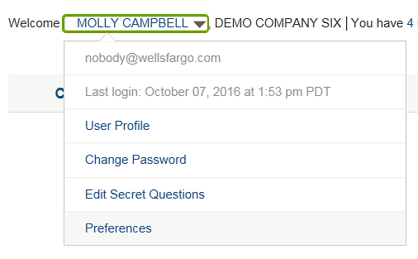
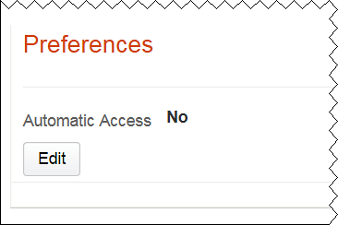
CEO® Home
Access the Commercial Card Expense Reporting service
Click the link for Commercial Card Expense Reporting. A separate browser window opens and displays the CCER service
Click on Help to register for free online CEO product training and to download Quick Reference and User Guides.
If CCER is the only service that you will access, you can choose to automatically open CCER each time you sign on - bypassing the CEO home page (Edit Automatic Access / turn on and Save)
13

Slide 14
Cardholder experience

Slide 15
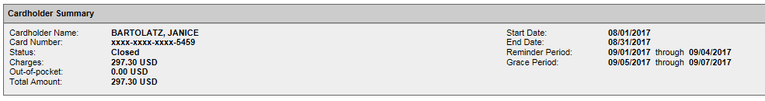
Cardholder review period
Unique to your program
Review your company’s unique CCER statement cycle, and Reminder and Grace Periods within the Cardholder Summary located at the top of the Review Open Statements and View Cycle-to-Date screens
An email will be sent out to Cardholders (and Reconcilers) when the current statement cycle has ended, indicating that the statement can be submitted for approval (Statement Reviewed). An email will be sent, even if the Cardholder doesn’t have any transactions for that statement cycle. If the statement end date falls on a weekend, the email will be sent the following Tuesday.
If the Cardholder (or Reconciler) has not reviewed and submitted the statement after 4 calendar days, a reminder email will be sent out. Cardholders and Reconcilers will have an additional 3 days grace to complete the review.
If you are on vacation or do not have online access, contact your Program Administrator.

Slide 16
E-Mail notification
Cardholder statement ready for review
Statement review for 05/31/20XX
Dear Cardholder:
Your most recent statement is ready for review by accessing the Wells Fargo Commercial Card Expense Reporting system for the following card(s):
xxxx-xxxx-xxxx-1234
Please complete your review in a timely manner and forward your receipts as appropriate.
This is an automated email. Please do not reply to this message.

Slide 17
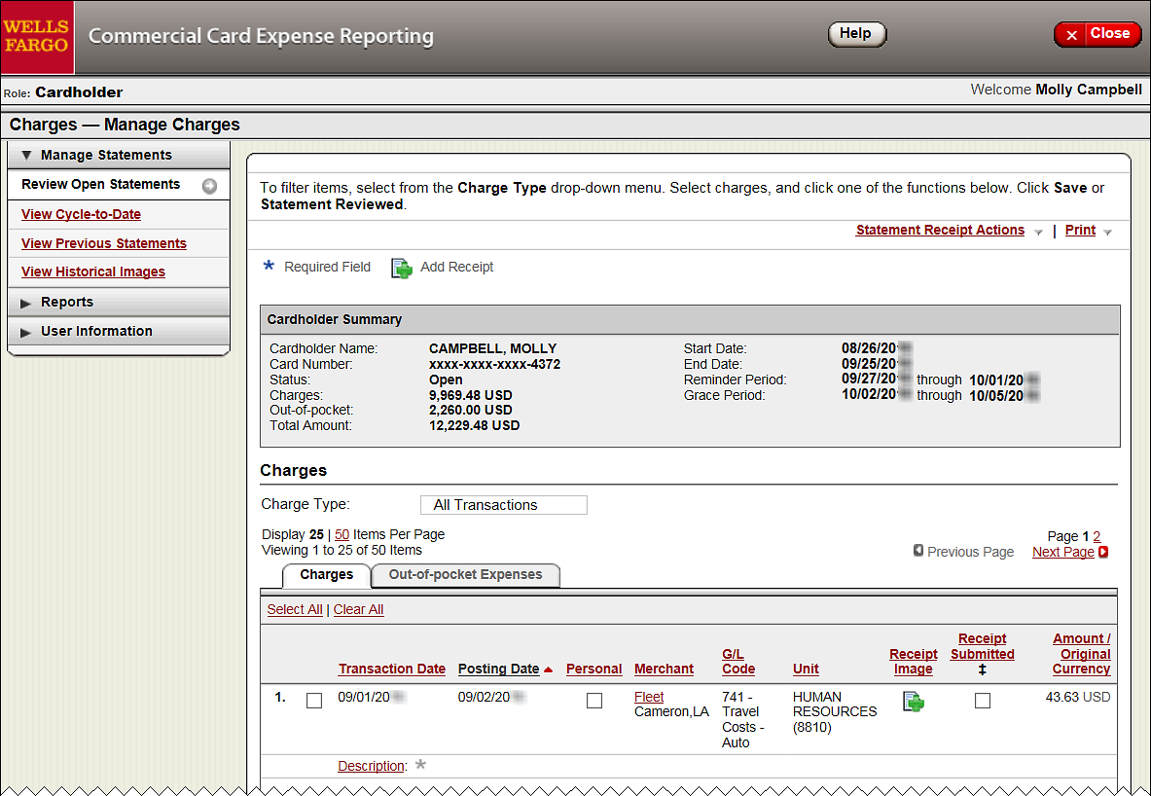
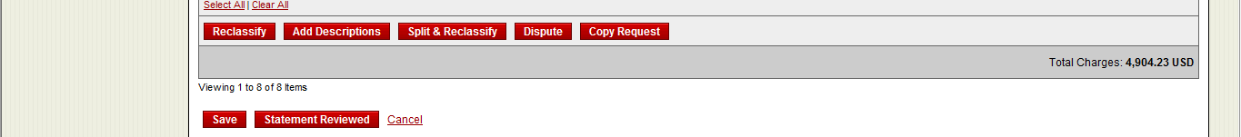
Cardholder home page
Manage Statements – Review Open Statements
  Review open statements (default screen for cardholders) will become available when your company has reached the statement End Date
  Finalize the statement during the review period
The Statement Reviewed button (which submits the expense report to the Approver) will only be available in Review Open Statements
17

Slide 18
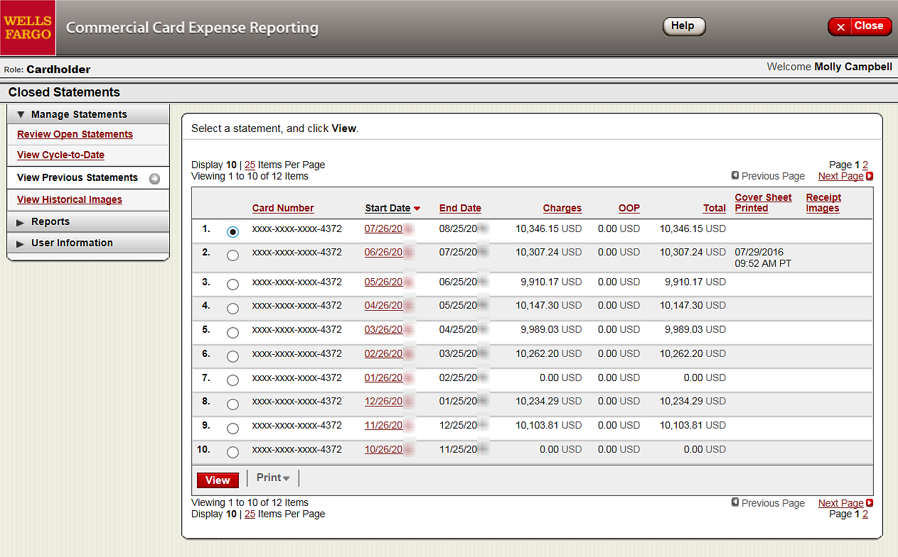
Manage Statements
View Previous Statements – 13 month history
18

Slide 19
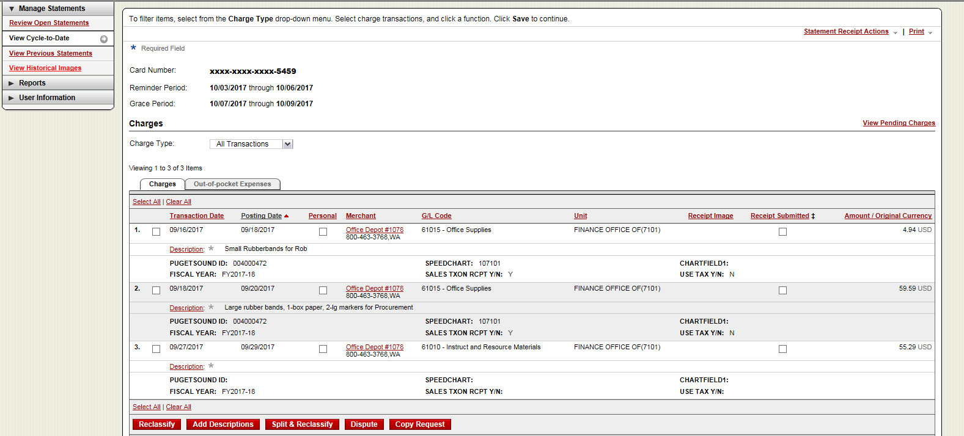
Manage Statements
View Cycle-to-Date Transactions
  Transactions appear on your statement as they are posted through the system
  To view Real-Time Authorizations, click on the View Pending Charges link
19

Slide 20
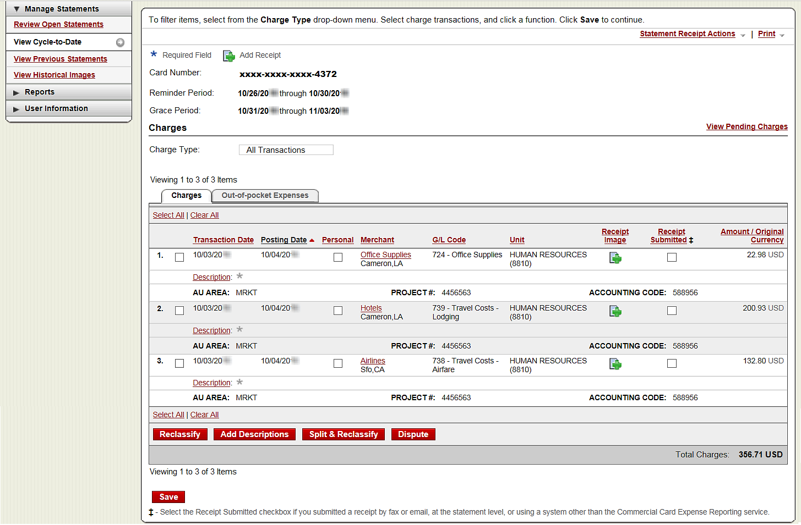
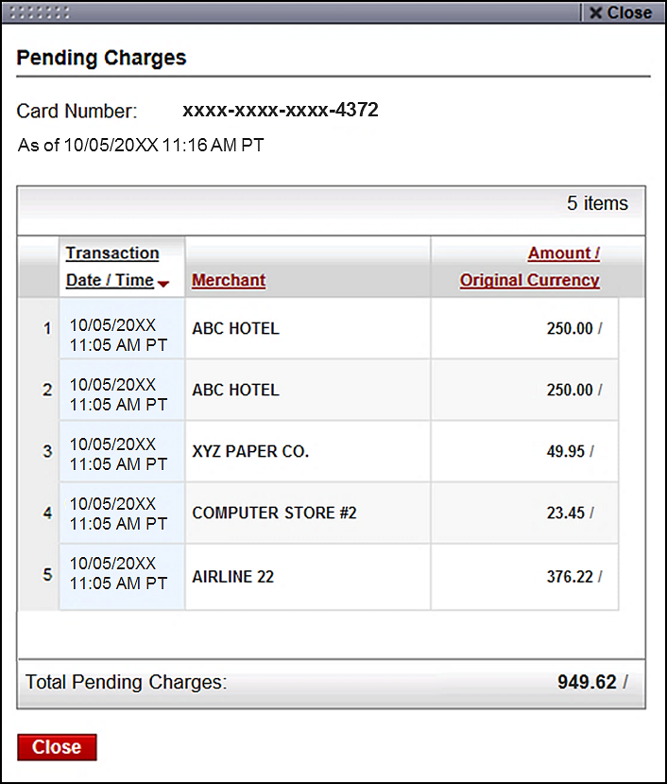
View Pending Charges
Within Cycle-to-Date (only)
20

Slide 21
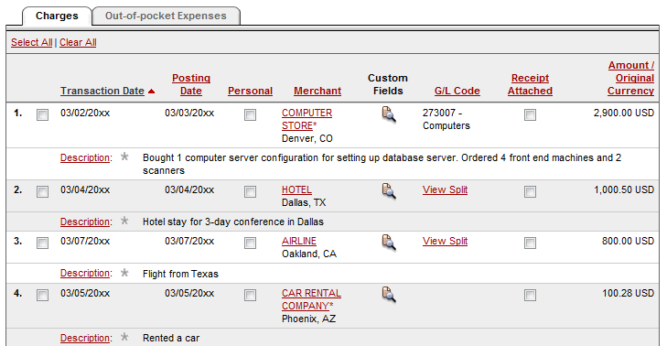
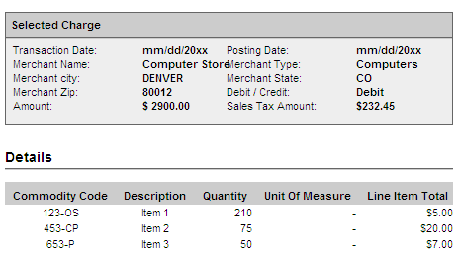
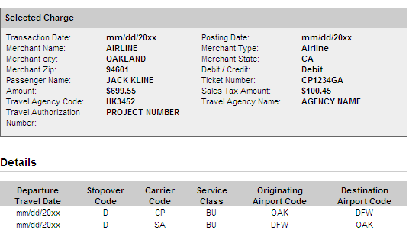
If a vendor transmits
additional details with
the transaction, the
merchant name is
red and underlined
Select the merchant name to access the detail screen

Slide 22
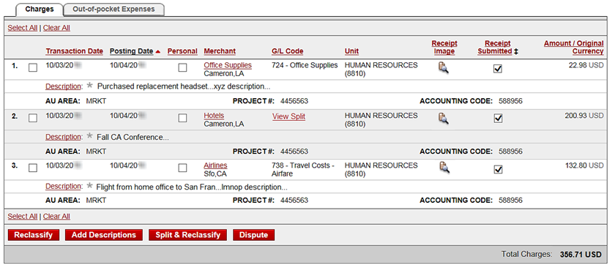
Available functionality includes:
  Reclassify - allocate an entire transaction and add a description
  Add Descriptions - provide transaction details
  Split and Reclassify - divide a transaction multiple ways and add descriptions
  Dispute - dispute a transaction

Slide 23
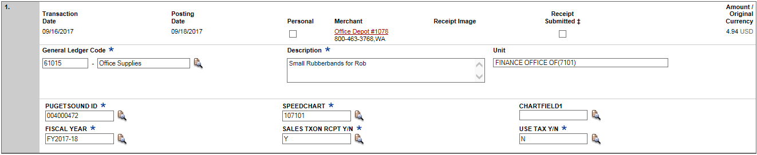


Reclassify screen
Click the icon to reclassify the general ledger code
Enter a business description
Click the icon(s) to choose values to allocate the transaction
  Avoid special characters - < > % ; ( ) & + \ # ? { } I ^ ~ [ ] “ ‘
  Please note the system will timeout after 15 minutes of inactivity. You will receive a warning message shortly before the session is set to expire.

Slide 24
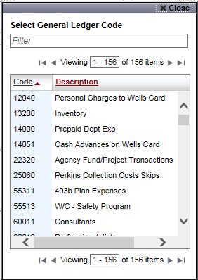
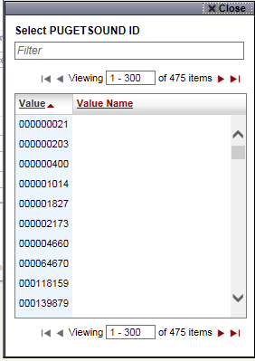
Reclassify screen

Slide 25
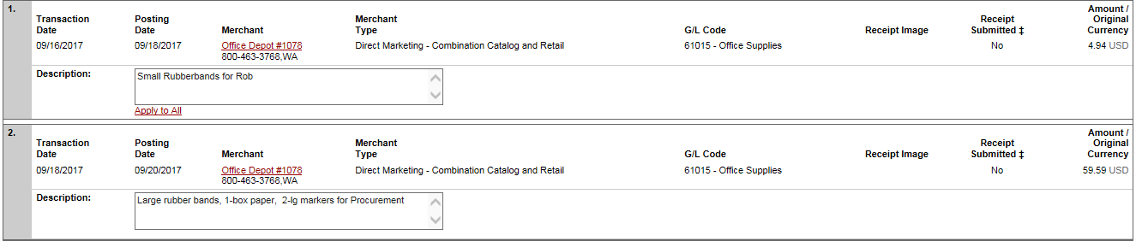

  Add Descriptions
  To multiple charges (selected on the main statement screen)
  Add a transaction description (can be up to 200 characters)
  Click the Apply to All link to apply the same description to all selected charges
  Provide name of guests entertained (if applicable)
  Adhere to company policy
  Avoid special characters - < > % ; ( ) & + \ # ? { } I ^ ~ [ ] “ ‘

Slide 26
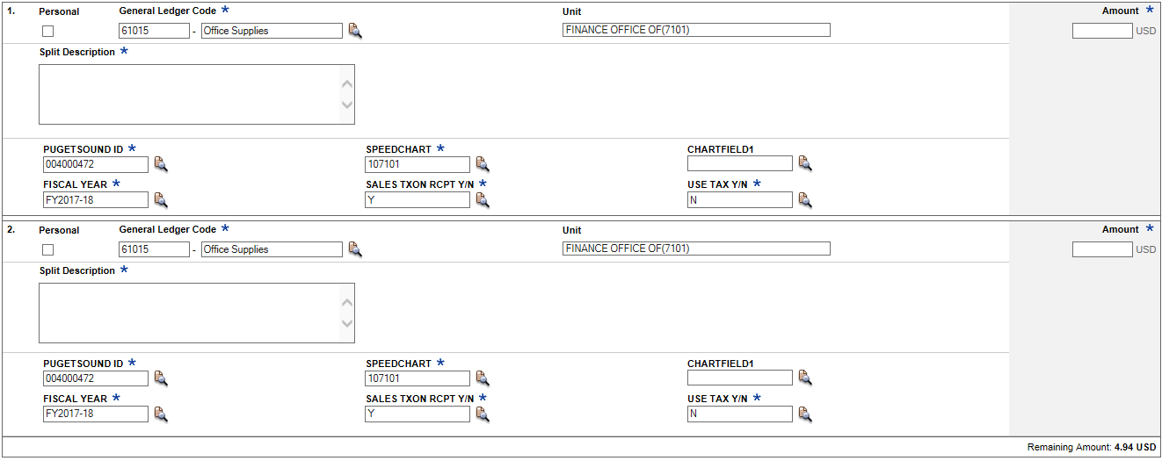

Split and Reclassify
Itemize a charge out to multiple GL Codes (by amount or %)
  Divide and reallocate a transaction into multiple entries
  Split by amount or by percentage
  Select add to create a new row and begin the split process

Slide 27
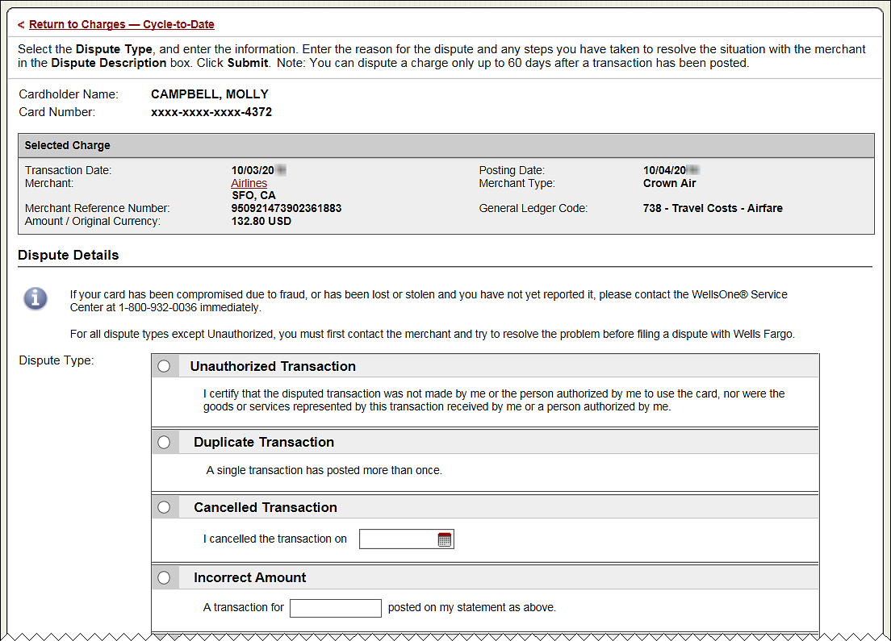
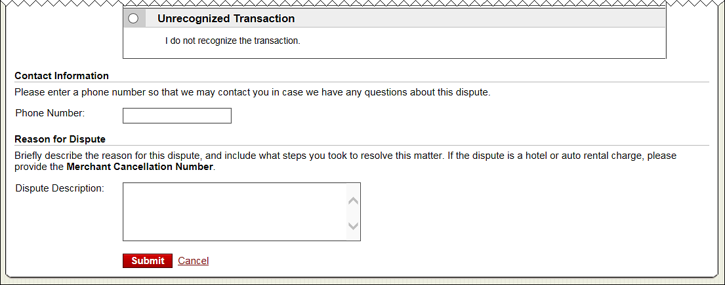
Dispute
Contact the vendor FIRST to try and get a refund or correction
If unresolved after working directly with the vendor, complete the online (or paper) form
Notify program administrator of dispute
You have 60 days from the posting date to dispute a transaction
Additional supporting information may be requested
Call the service center if there are unrecognized transactions or suspected fraud
27

Slide 28
OOP reimbursement
CCER has the ability to reimburse miscellaneous, out of pocket (OOP) expenses as part of the statement reconciliation process
    Tips, tolls, mileage, parking
    Any small dollar expense that cannot go on the card
In addition, these OOP expenses can be sent directly to the cardholder’s designated account (checking or savings) via ACH
28

Slide 29
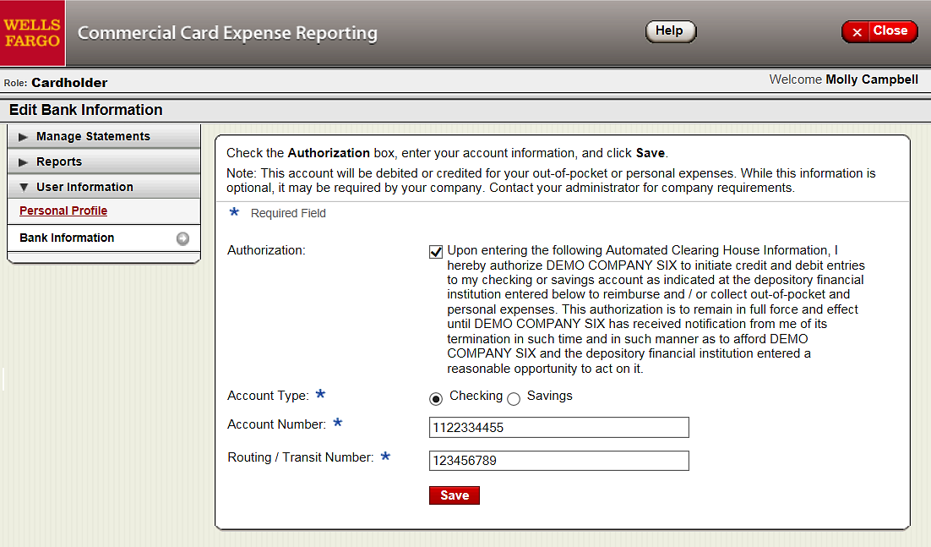
User Information - Bank Information
Account debited or credited for out-of-pocket or personal exp.
Select bank information from the left navigation menu and enter account information
Only cardholders and OOP only users have access to the bank information screen
29

Slide 30
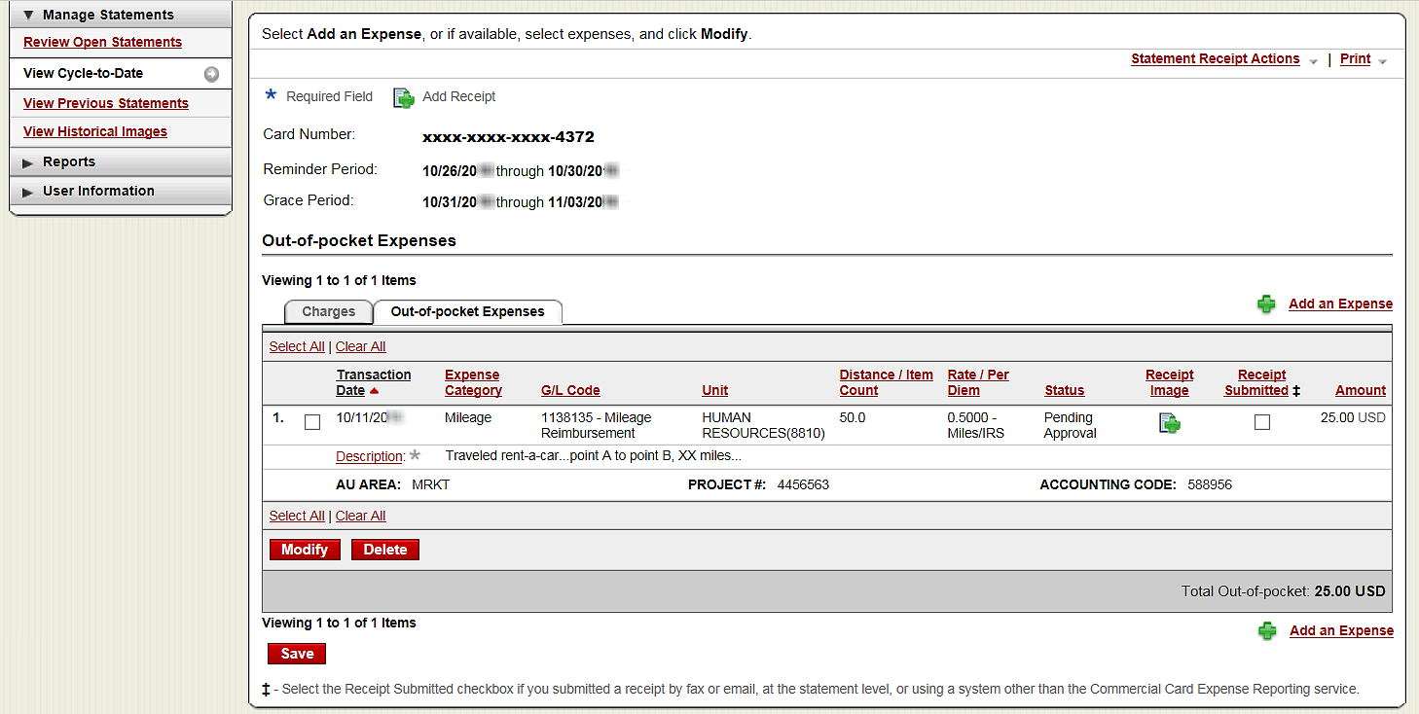
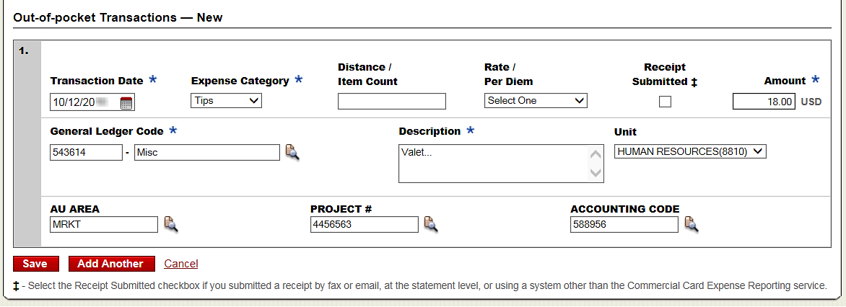

Out-of-Pocket expenses (OOP)
Select Add an Expense to enter mileage or cash items
  Enter date and choose an expense category
  Enter amount and add description for non-mileage OOP
  For mileage, enter distance, select rate and add description
  Modify the custom fields and general ledger code if necessary
30

Slide 31
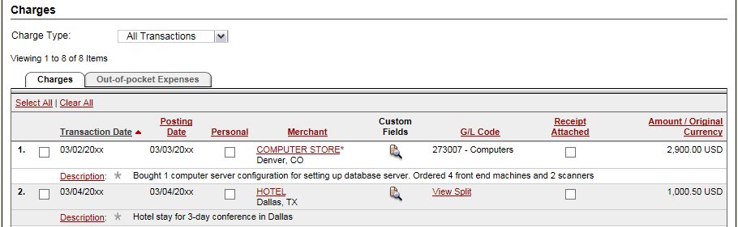
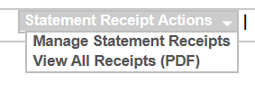
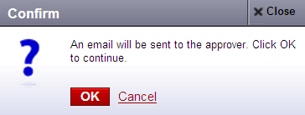
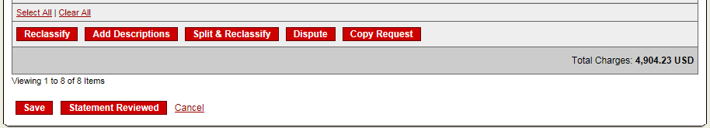
Complete your review
Select statement reviewed and a message box appears indicating that an email will be sent to your approver
Upload receipts via desktop or CEO mobile. To email or fax, select cover sheet option on the “print” drop-down menu to print the cover sheet for this statement.

Slide 32
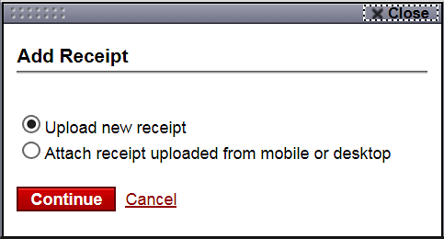
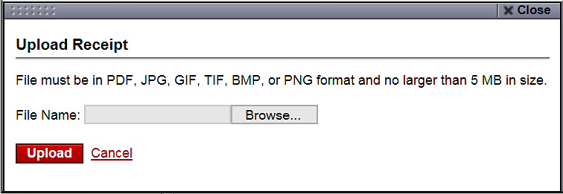
Desktop Receipt Imaging option
Upload receipt images to individual transactions (Add Receipt)
32
Notes:
In either the Open Statement or Cycle-to-Date statement - you can upload receipt images to individual transactions.
You will first need to scan-in and save receipt images somewhere on your PC.
Navigate to the correct tab (Charges or OOP Expenses), find the appropriate transaction, and click the Add Receipt icon in the Receipt Image column.
You have the options to Upload a new receipt, or Attach a receipt uploaded via the Desktop or Mobile that’s sitting at the statement-level (Continue).
When uploading a new receipt, Browse your PC for the appropriate file containing the image and click Upload.
Files must be in PDF, JPG, GIF, TIF, BMP, or PNG format and no larger than 5 MB in size.
Note that you can upload receipts for the previous 13 months of statements (in View Previous Statements).

Slide 33
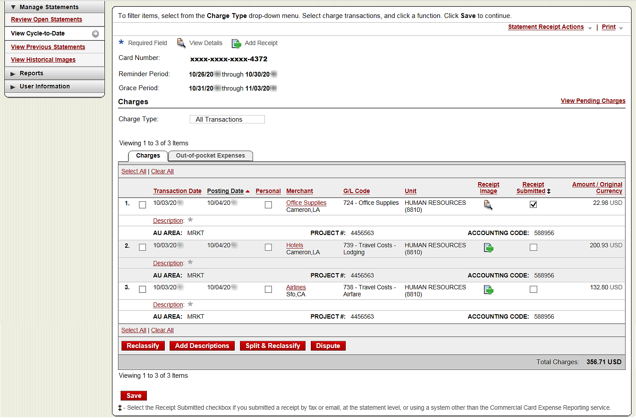
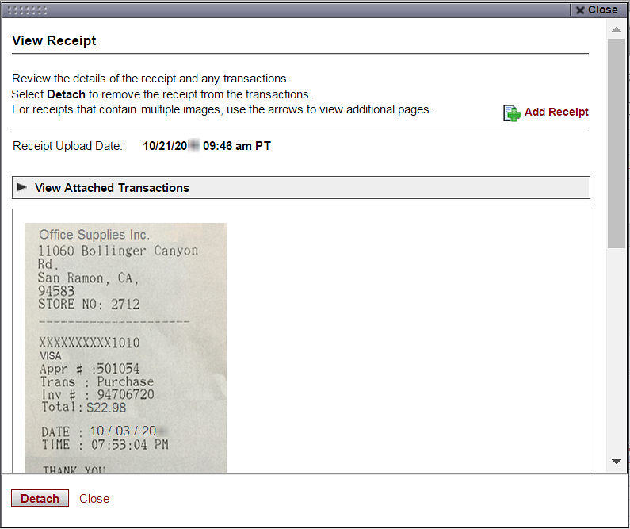
Desktop Receipt Imaging
View/Detach uploaded receipt images (View Details)
33
Notes:
You can view receipt images after they have been uploaded to individual transactions by selecting the View Details icon in the Receipt Image column.
Note that you must manually check the Receipt Submitted check box after uploading a receipt. It will not automatically update.
When viewing a receipt, you can Detach it from the transaction below in the viewer window.
This will remove the attachment to the transaction but will leave the receipt at the statement-level.
In order to delete a receipt from the system, visit the Statement Receipt Actions dropdown (Manage Statement Receipts) in the upper right corner.

Slide 34
Desktop Receipt Imaging
Upload receipt images to statement (attach to transactions later)
34
Notes:
Receipts can be uploaded to the statement-level via Desktop (or Mobile) and attached to transactions later.
In either the Open Statement or Cycle-to-Date statement, select the Statement Receipt Actions dropdown menu in the upper right corner (Manage Statement Receipts).
This is also the only area where uploaded receipts can be deleted.
Within this dropdown, you may also view a file of all receipts uploaded (View All Receipts PDF).
Note that you can upload receipts for the previous 13 months of statements (in View Previous Statements).

Slide 35
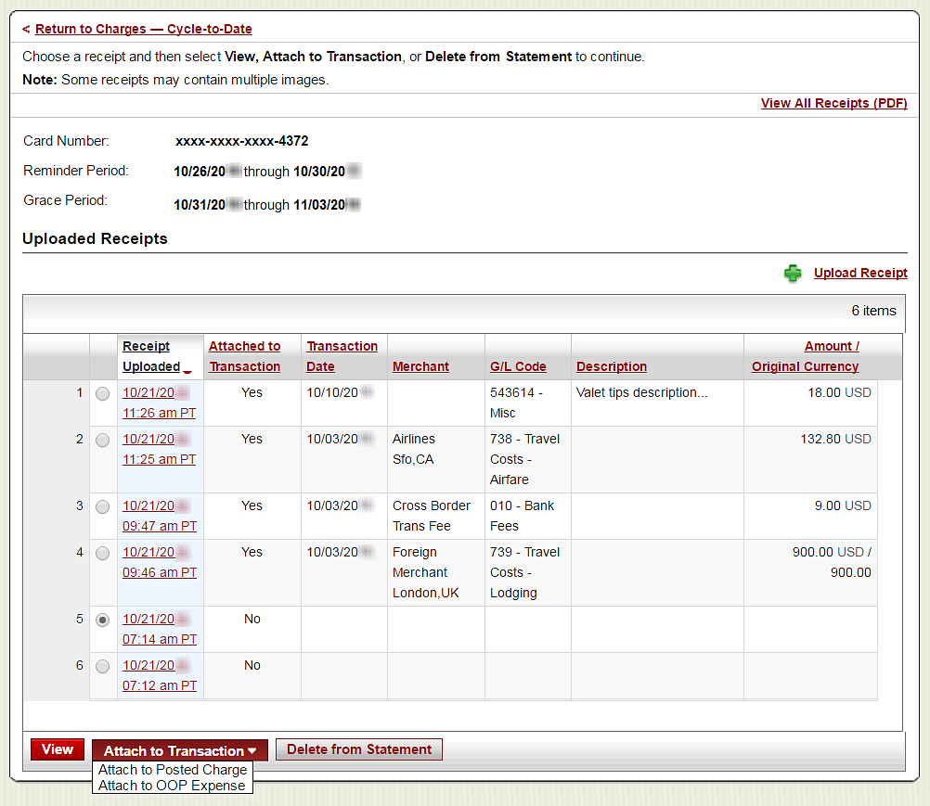
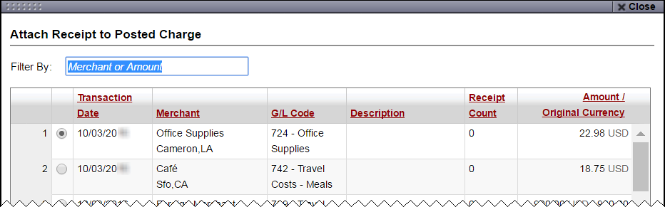
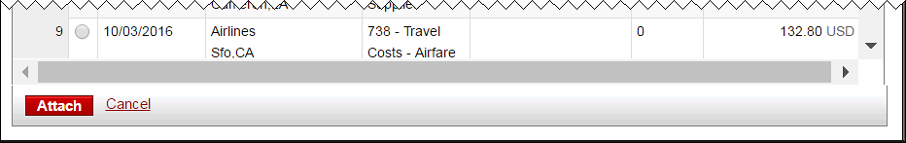
Desktop Receipt Imaging
Upload receipt images (to statement), View, Attach, or Delete
35
Notes:
In the Manage Statement Receipts window, you can upload receipts to the statement-level (+ Upload Receipt link).
Select the radio dial for an uploaded receipt to View the image, or Delete from the Statement below. You may also select the date/time stamp hyperlink to open up the receipt image as well.
Images already tied to a transaction will have the line item details filled out.
Statement-level receipts that are not attached to a transaction can be filtered using the “Attached to Transaction” column. Also look for the images without any line item details.
Select receipts that are not attached (Attached to Transaction = No), and use the Attach to Transaction dropdown menu below to Attach to Posted Charge, or Attach to OOP Expense.
On the following screen you can Filter By Merchant or Amount to find the appropriate transaction to tie the receipt to (select it, and Attach).

Slide 36



Receipt Imaging – Print Cover Sheet option
Fax or email receipt images (statement-level only)
Cover Sheet considerations:
If emailing:
Individual attachments must be in the following formats: PDF, JPG, GIF, TIF, BMP, or PNG
If you email a single attachment combining the Cover Sheet and receipts, it must be a PDF
Receipts submitted using this method:
Cannot be attached to individual transactions
Remain statement-level
Can be accessed in the Statement Receipt Actions dropdown, “View All Receipts (PDF)”
36
Notes:
Another option to submit receipts is the Cover Sheet method.
In either the Open Statement or Cycle-to-Date statement – you can Print the Cover Sheet from the Print menu in the upper right corner.
You have 2 options to image receipts this way:
1) Fax the Cover Sheet and receipts for the statement period to the Fax number provided on the Cover Sheet.
OR
2) Scan and email the Cover Sheet along with the receipts for the statement period to the E-mail address provided on the Cover Sheet.
Individual attachments must be in the following formats: PDF, JPG, GIF, TIF, BMP, or PNG.
If you email a single attachment combining the Cover Sheet and receipts, it must be a PDF.
It is important to note that receipts submitted using this method:
-Cannot be attached to individual transactions
-Remain statement-level
-Cannot be deleted through the system
-Can be accessed in the Statement Receipts Actions dropdown, “View All Receipts (PDF)”.
Note that you can print the Receipt Imaging cover sheet for the previous 13 months of statements (in View Previous Statements).

Slide 37

Mobile Receipt Imaging option
Upload pictures of receipts using your mobile device
Via your mobile browser:
Go to https://ceomobile.wellsfargo.com or download the free Wells Fargo CEO Mobile app for iPhone/iPad or Android
Mobile Cardholders can:
Add and edit Out-of-Pocket expenses
View pending and posted card charges
Add and edit descriptions
View available credit
View declines
Upload receipts
37
Notes:
Another option to submit receipts is through CEO Mobile.
You can upload pictures of receipts to individual transactions (or statement-level) using your mobile device.
Go to the CEO Mobile website (https://ceomobile.wellsfargo.com) or download the free Wells Fargo CEO Mobile app for iPhone/iPad from the Apple App Store, or for Android from the Google Play store.
Mobile Cardholders can view pending and posted card charges, add/edit descriptions, view available credit, view declines, and upload receipts.
Transaction-level imaging is currently only available for iOS users; Android in March 2017.
Note Reconciler and Approver roles are not available via CCER Mobile.

Slide 38



Mobile Receipt Imaging
Getting started…
38
Notes:
To start the Mobile receipt upload process, tap Upload Receipt and then select to upload to a Posted Charge, an Out-of-pocket transaction, or to the *Statement-level (only).
Alternately, you can start in the Manage Statements flow to attach receipt pictures to transactions. In this flow, you select the applicable statement and scroll through transactions to find the one for which you will be uploading the receipt
On the Upload Receipt screen, You will be asked to pick the Statement Type from the dropdown menu (Open Statement or Cycle-to-Date). Make sure to select the appropriate statement you wish to upload receipts to.
*Note receipts uploaded to the statement-level only may be attached to the transaction level at a later date but only through the Desktop application (full site). Statement-level only receipts are not available for viewing in CCER Mobile.

Slide 39


Mobile Receipt Imaging
Take a photo or select receipt images from your gallery
39
Notes:
After selecting Continue, hold the camera over your receipt and follow the prompts. The image will be captured automatically.
The service will automatically assist you in getting the best image possible before uploading the receipt. When invoking the camera for image capture, you will be presented with options to frame the receipt, crop the receipt or adjust the image. Messages giving tips to help you take the best image possible will be provided.
Tap the Retake icon at the bottom of the picture window to retake the captured picture.
Tap the +Add icon to upload additional images.
Tap the Crop box to crop the picture.
Tap Done when finished.
Alternately, tap the photo gallery icon (4-squares) to upload up to 5 images from your photo gallery (select Done when finished).

Slide 40



Auto-matching
CCER Mobile will attempt to match receipt images with expenses
40
Notes:
Upon taking the receipt image picture or selecting the image from your picture gallery, our system will read the receipt data, try to find a matching Charge or OOP Expense, and present up to 3 matched items to you. It may be less if the system doesn’t find 3.
Select the correct transaction (if more than one is presented) and tap Attach to complete the upload and attach process.
If the CCER service did not return the correct transaction for matching, you may choose to manually find the correct transaction for attachment or upload to the statement level.
Edit receipt data to update the Matching Expenses list, or select from (ALL) Charge/OOP Expenses, or *Upload to Statement Only below.
Select Done when finished.
Choose to send yourself an Email confirmation as needed (Yes/No), and Submit.
*Again, note receipts uploaded to the statement-level only may be attached to the transaction level at a later date but only through the Desktop application (full site). Statement-level only receipts are not available for viewing in CCER Mobile.

Slide 41


Upload through Manage Charges/Expenses
Use if not leveraging auto-matching
Notes:
When uploading several receipts at a time and/or when not leveraging auto-matching to tie receipts to transactions, you can also upload receipts through Manage Charges or Manage Out-of-Pocket OOP Expenses.
To start the process of adding receipts through this flow, select Manage Charges or Out-of-pocket Expenses from the CCER mobile home screen.
Next, select the Statement Type from the dropdown menu (Open Statement or Cycle-to-Date). And Continue.
On the following Manage Charges screen tap Upload Receipt(+) to the right of the posted charge or existing Out-of Pocket (OOP) expense you want to upload to.
You will complete the image capture flow using your camera or picture gallery (shown earlier) and Submit.

Slide 42



Add a new Out-of-Pocket (OOP) expense
Mobile receipt information is used to create a new expense
Notes:
If you choose to “Add an OOP Expense” for a receipt, the system will start the new transaction using the date and amount extracted from the receipt image.
You will need to add the expense category and description.
After submitting the new expense you will be able to validate that it’s been added along with the receipt image.

Slide 43



Receipt Imaging
Viewing Images
View images by clicking the “view all receipts (PDF)” link found under Statement Receipt Actions on the open statements, cycle-to-date, and previous statement screens
Print cover sheets for prior statements on the view previous statement screen
View historical images for up to seven years via “view historical images”

Slide 44


Reports
Run transaction reports with various filters
You are notified via e-mail when the report is ready
View declined transactions to determine the reason for the decline
Declines do not appear in real time, they will be displayed within 48 hours

Slide 45



Personal profile
Click on link to Manage Alerts
Billing address for online and phone orders
You can also contact the
WellsOne Service Center 24/7 at
1-800-932-0036 to obtain available credit.
Must provide Unique ID to
obtain any information
Click to retrieve current available credit

Slide 46

Commercial Card Account Services
Contact Information (mobile # and email address for alerts)
When managing alerts, you’ll be brought to the Commercial Card Account Services page (CCAS)
In the Contact Information menu on the left, identify either your mobile phone number or email address. Enter both to receive both text and email alerts
Alerts cannot be sent to international phone numbers
Submit when finished
46

Slide 47

Commercial Card Account Services
Alerts offered for purchases and available credit
A Purchase Threshold is required for general Purchase alerts (alerts are sent when this threshold is exceeded)
Online Purchase alerts are issued on all online card activity
The Available Credit alert is requested by texting “Avail” to 93236 (amount of available credit is be received back via selected delivery channels)
During first time enrollment, if alerts are set to “by Text”, you will receive an Opt-In text message on your mobile device (reply “YES” or “START”)
Email alerts do not have an opt-in process so they will begin immediately
47
Notes:
In the Manage Alerts menu on the left, manage the alert types activated by your company/program.
For each alert, you may choose “None”, “by Text”, “by Email”, or “by Text and Email” (depending on your company’s allowed delivery channels).
A dollar threshold (Purchase Threshold) is required for general Purchase alerts. Alerts are sent when this dollar threshold is exceeded. Values entered must be in whole dollars (minimum $1.00).
Dollar thresholds are not available for Online Purchases. Alerts issued include all online authorizations, declines, credits, and reversals.
The Available Credit alert is a two-way inquiry. It can only be requested by texting the word “Avail” to 93236. Amount of available credit can be received back via text or email or both depending on which delivery option is selected here.
During first time enrollment, if any alert types are set to the delivery channel of “by Text”, you will receive an Opt-In message on your mobile device and you must opt-in for the service by texting “YES” or “START” as a reply back. No texts will be sent to your mobile number until you opt-in. Email alerts do not have an opt-in process so they will begin immediately.
Submit when finished.

Slide 48
3D Secure
Industry name for Verified by Visa or MasterCard SecureCode
3-D Secure technology secures online transactions using an additional level of cardholder authentication. International and now U.S. internet merchants are beginning to require 3-D Secure to complete transactions.
How it works
Cardholders must register their card online prior to completing their purchase at a 3-D Secure enabled merchant.
As part of the registration process, you will need to provide correct answers to 3 identity authentication questions. You will then create a personal passcode to be used for future purchases.
Once enrolled, you will be prompted to input your personal passcode during the checkout process at 3-D Secure enabled merchants.
How to enroll
In order to enroll in this free, online security service, cardholders must register their card at:
  https://www.wellsfargo.com/com/fraud/payments-fraud/ (click on the Commercial Card Fraud tab and then on either the Visa or MasterCard link)
  During the registration process you will be asked to provide the last four digits of your Unique ID, your monthly credit limit, and the zip code tied to your card to verify your identity (this information can be found in your CEO CCER Personal Profile). Once this information has been provided, you will create a personal passcode to be used when making online purchases with participating merchants.
  If you are having any trouble, please call the WellsOne Service Center at 800-932-0036, option 2.

Slide 49
Cardholder Responsibility
Collect receipts to verify purchases for auditing
Watch for unauthorized transactions on your statement and report/dispute them immediately
Dispute any incorrect charges with the vendor directly before filing an online or paper dispute form
Complete your reconciliation by the due date
Keep the card (and card number) confidential

Slide 50
Contact information
WellsOne Service Center - 1-800-932-0036
  From outside of the United States call 1-612-332-2224
  Call immediately if your card is lost, stolen or suspected missing
  For immediate decline information
  To access the automated voice response system for the following information:
    Current balance
    Available credit
    Reset PIN
Contact a program administrator if:
  You have questions about your card
  Need to increase your credit limit
  Change jobs
  Need to order cards for other employees
Program Administrators:
Jan Bartolatz 253-879-3224
jbartolatz@pugetsound.edu

Slide 51
Approver experience

Slide 52

Approver review period
Unique to your program
Review your company’s unique CCER statement cycle, and Approval period within the Cardholder Summary located at the top of the Review Open Statements and View Cycle-to-Date screens
An email will be sent to the Approver once Cardholders have submitted their statements for approval (Statement Reviewed). An additional email will also be sent listing any Cardholders that failed to submit their statements by the grace period end date.
Approvers must approve all statements by 5 calendar days after the end of the Cardholder period.
If an Approver fails to approve Out-of-pocket Expenses before the Approver deadline, the expenses will not be submitted for reimbursement, and will reappear on the next statement cycle.
If you are on vacation, or do not have online access, contact your Program Administrator so a secondary Approver can be assigned to your Cardholders.

Slide 53
E-Mail notification
Cardholder review of statement is complete
Cardholder statement review complete
Dear Approver:
The most recent statement has been reviewed for the following cardholder:
Lastname, Firstname
xxxx-xxxx-xxxx-1234
xxxx-xxxx-xxxx-5678
The statement(s) are ready for your review by accessing the
Wells Fargo Commercial Card Expense Reporting system
Please complete your review in a timely manner.
This is an automated email. Please do not reply to this message.

Slide 54
E-Mail notification
Approver mail (after grace period end date)
Cardholder statement review overdue for 05/31/20XX
Dear Approver:
The following cardholder(s) have not reviewed their most recent statement:
Lastname, Firstname xxxx-xxxx-xxxx-1234
Lastname, Firstname xxxx-xxxx-xxxx-5678
Notifications have been sent to each cardholder but they have still failed to review their statement. If you choose, you may review the statement on the cardholder’s behalf by accessing the Wells Fargo Commercial Card Expense Reporting system.
This is an automated email. Please do not reply to this message.

Slide 55

Approver home page
Manage Statements – Approve Statements
Statement approval queue (if the cycle is ready for review)
View a statement-level PDF of all images by clicking the link in the receipt images column
Select the statement and click View to see all transactions and transaction level images if available.
Notify program administrator if a secondary approver is needed
55

Slide 56



Manage Statements
View Cycle-to-Date Transactions
Approvers can view mid-cycle activity and submitted receipts for any user that rolls up to them for approval

Slide 57

Approve OOP Expenses (separately)
Select transactions
Click to Out-of-Pocket Expenses tab to view and approve OOP expenses
Approve the OOP expenses independent of the transactions to ensure the cardholders get reimbursed
If an approver fails to approve out-of-pocket expenses by the approver deadline, the expenses will not be paid out and will re-appear on the next statement
57

Slide 58

Approve over-all statement
Make any necessary changes prior to approving
Review transaction detail, descriptions, receipts, and make sure all are in compliance with company policy for both charges and OOP
Approve the card expenses by clicking “approve statement”
58

Slide 59



Manage receipts
Review receipts/view historical images tabs
Contains two tabs that allow the approver to select a particular statement period and view receipts:
Review receipts tab contains data for the last twelve months
View historical images tab contains data for the last seven years

Slide 60

Reports – statement summary
Approver option – review up to 12 statement cycles
Statement summary report showing cardholder statements over period of time

Slide 61


Reports – offline
Approver option – Create New Report
View & Print (PDF) or Download report data to Excel
Approver will receive an email when the report is ready to view

Slide 62
Thank you!
© 2017 Wells Fargo Bank, N.A. All rights reserved. Confidential.

